Slide 1
Skin: Alopecia
Alopecia
Drugs | Anthracyclines Bleomycin Carboplatin Oxaliplatin Cyclophosphamide Irinotecan Taxanes
When it occurs | 1 – 2 cycles

Slide 2
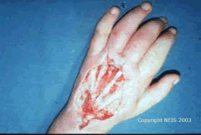
Vesicant Agents
Vesicant Agents (cause blisters) | Warm Vs Cold Tx | Treatments
Etoposide | Warm | Hyaluronidase
Vinca alkaloids | Warm | Hyaluronidase
Paclitaxel | Cold | Hyaluronidase
Anthracyclines | Cold | DSMO
Mitomycin | --- | DMSO
Nitrogen Mustard | --- | Na Thiosulfate
Oxaliplatin | --- | Na Thiosulfate

Slide 3
Peripheral Neuropathy
Drugs | Bortezomib Cisplatin (Platinol) Taxanes Thalidomide Vinca Alkaloids
Tx | Narcotics TCA Anticonvulsants

